Slide 1
California Wildfire Hazard Correlation Project
Jeffrey Kennedy

Slide 2
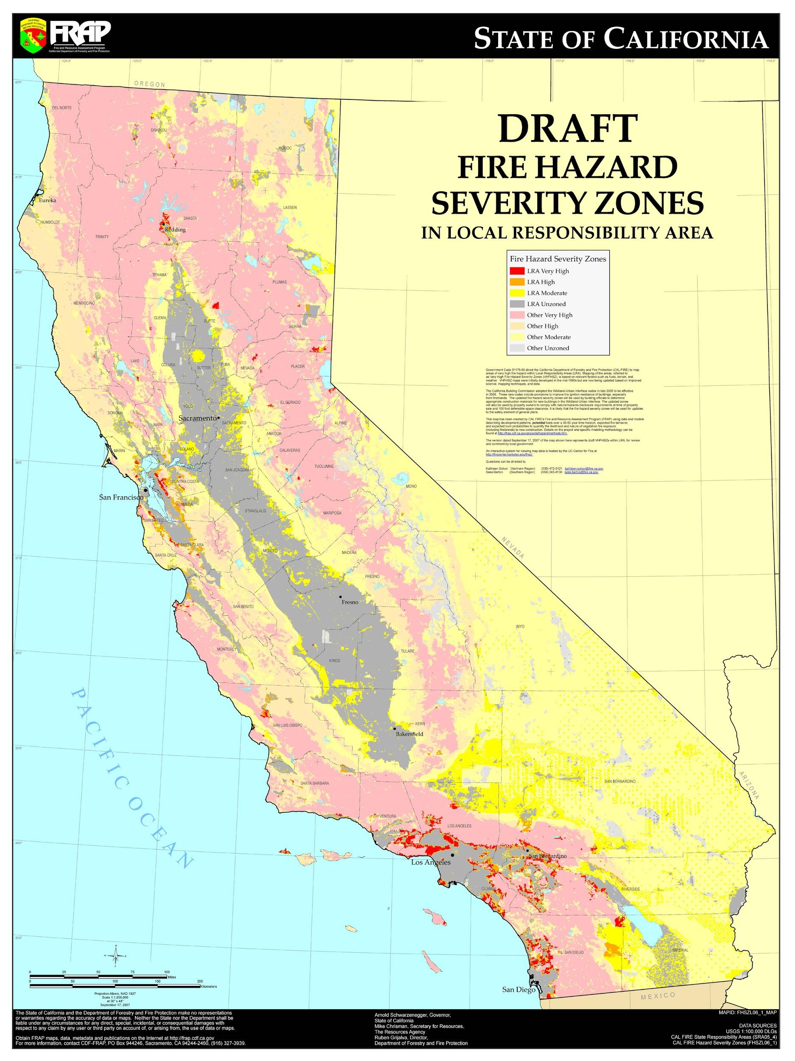
Background
According to CAL FIRE, 16 of the top 20 most destructive fires in California history have been within the last 20 years.
Of those 1 was caused by lightning, 4 are either undetermined or still under investigation, and the rest were caused by some interaction with people or infrastructure.
Current California fire hazard elements are calculated primarily using natural features such as vegetation, topography, weather, and crown fire potential.
This project uses python to look for correlations between human caused wildfires and locations where people frequent in order to lay the foundation for a future fire hazard element based on human-fire interactions.
In short, predict where human-caused fires are likely to occur.

Slide 3
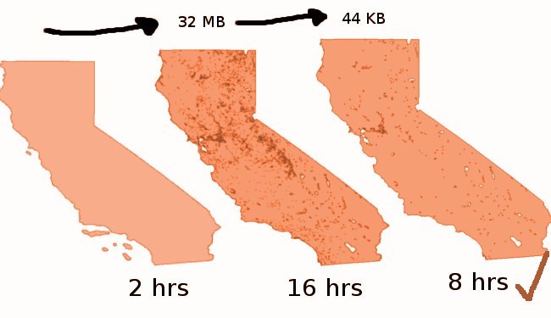
Data
FIRES
USDA Forest Service - Karen C. Short: Spatial wildfire occurrence data for the United States, 1992-2015 (4th Edition)
https://www.fs.usda.gov/rds/archive/Product/RDS-2013-0009.4/
LOCATIONS
CA Department of Park and Recreation - California State Park Entry Points
https://www.parks.ca.gov/?page_id=862
Caltrans GIS Data - Safety Roadside Rest Areas, California, 2015
https://purl.stanford.edu/tc473kk8140
Caltrans GIS Data - Vista Points, California, 2015
https://purl.stanford.edu/tr330qq8079
Tom Hillegass - CA Campgrounds
http://www.uscampgrounds.info/takeit.html
BOUNDARY
CA Open Data Portal - CA Geographic Boundaries
https://data.ca.gov/dataset/ca-geographic-boundaries
NOS80k - Medium resolution digital vector U.S. shoreline.
https://pubs.usgs.gov/of/2006/1251/
California Lakes (zip)
https://www.wildlife.ca.gov/Data/GIS/Clearinghouse

Slide 4
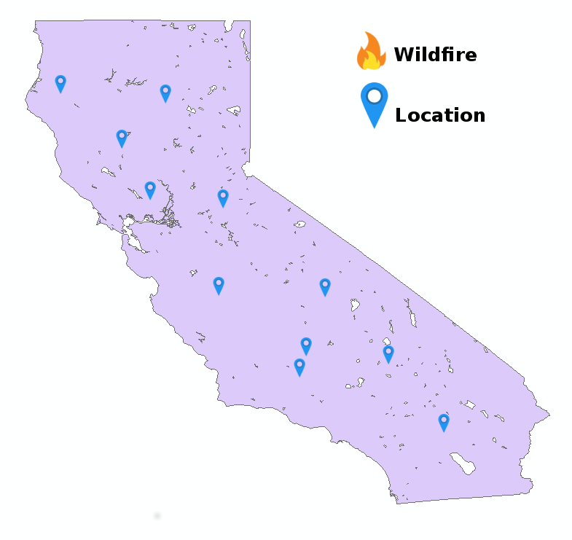
Monte Carlo Method
Generate Random Points inside
CA Shapefile.
Number of random points equal to
number of points each location has:
LOCATION TYPE POINTS
Campgrounds 1300
Vista-Points 146
State Parks 288
Rest Stops 87
Find latitude longitude coordinates of each point.

Slide 5
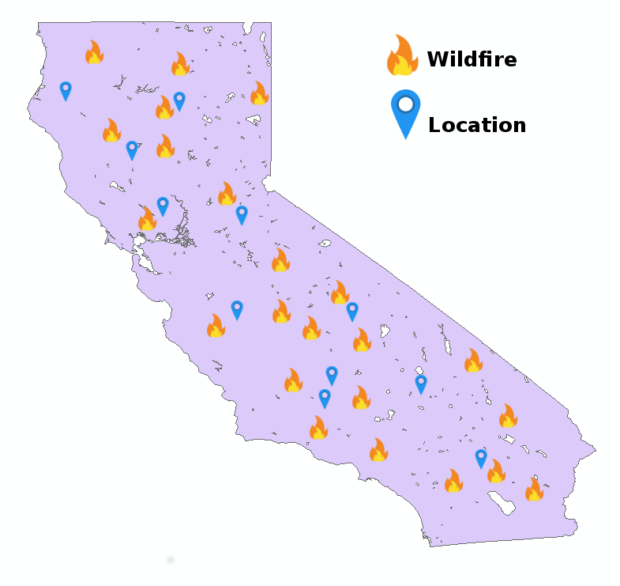
Monte Carlo Method
Human-caused wildfires,
separated by type, also have X,Y
coordinates.
WILDFIRE TYPE POINTS
Arson 19636
Campfire 9516
Children 6930
Debris 14318
Equipment 39407
Fireworks 219
Powerline 1198
Railroad 1998
Smoking 5935

Slide 6
Monte Carlo Method
Calculate distance between
every wildfire point and every
location point.
Find the closest location point to
each wildfire point.
Average the all the distances between each
fire and its closest location.

Slide 7
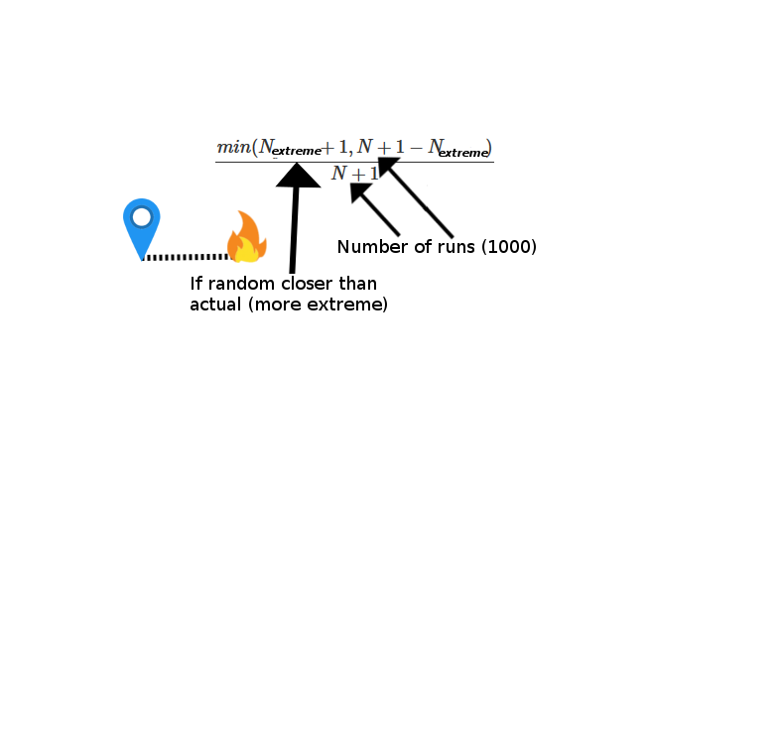
Monte Carlo Method
Repeat process 1000 times.
Now know the average distance each wildfire
would be from each location if the locations were distributed
randomly.
Compare average of each random run to actual average distance.
Calculate P value.
With P value, reject or accept the null: that this particular location type is no
better than random at predicting wildfire.

Slide 8
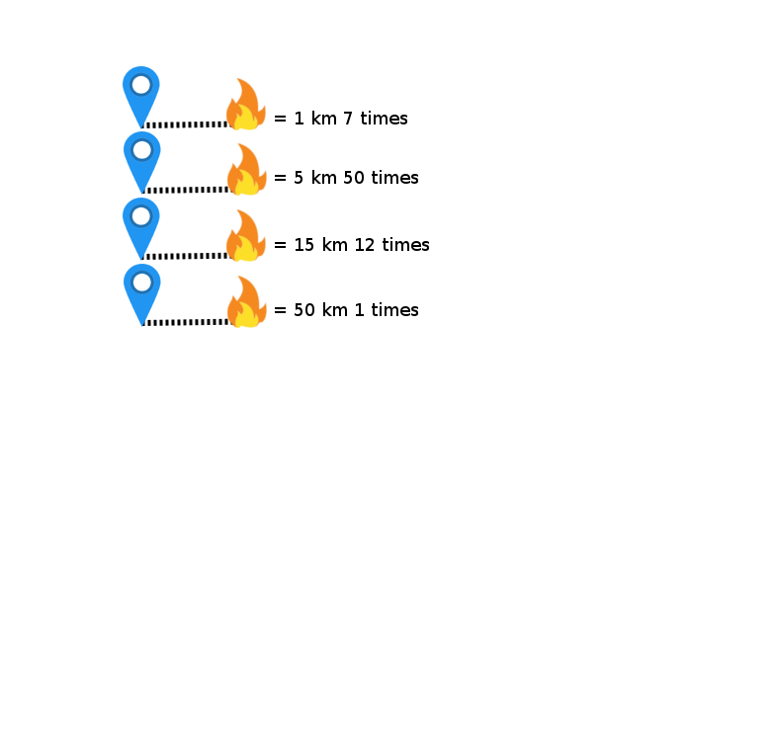
Frequency Analysis
Perform frequency analysis if null is rejected.
Rounds actual distances to nearest integer
to make this feasible.
Calculate R value and determine strength
of correlation.
If null is rejected and correlation strong, graph results.

Slide 9
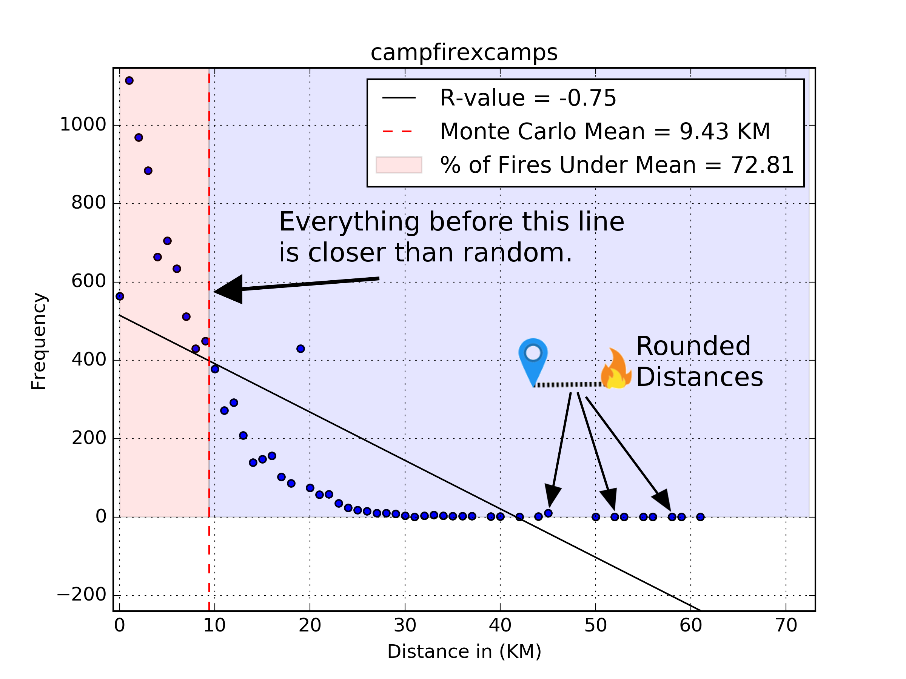
Results
Of the 36 location x wildfire
combination the null was
rejected 23 times.
3 had low R values, 6
moderate, 1 negligible, and
14 were highly correlated.
Litmus test: Camps and
Campfires must be highly
correlated if results are to be
assumed correct - success.

Slide 10
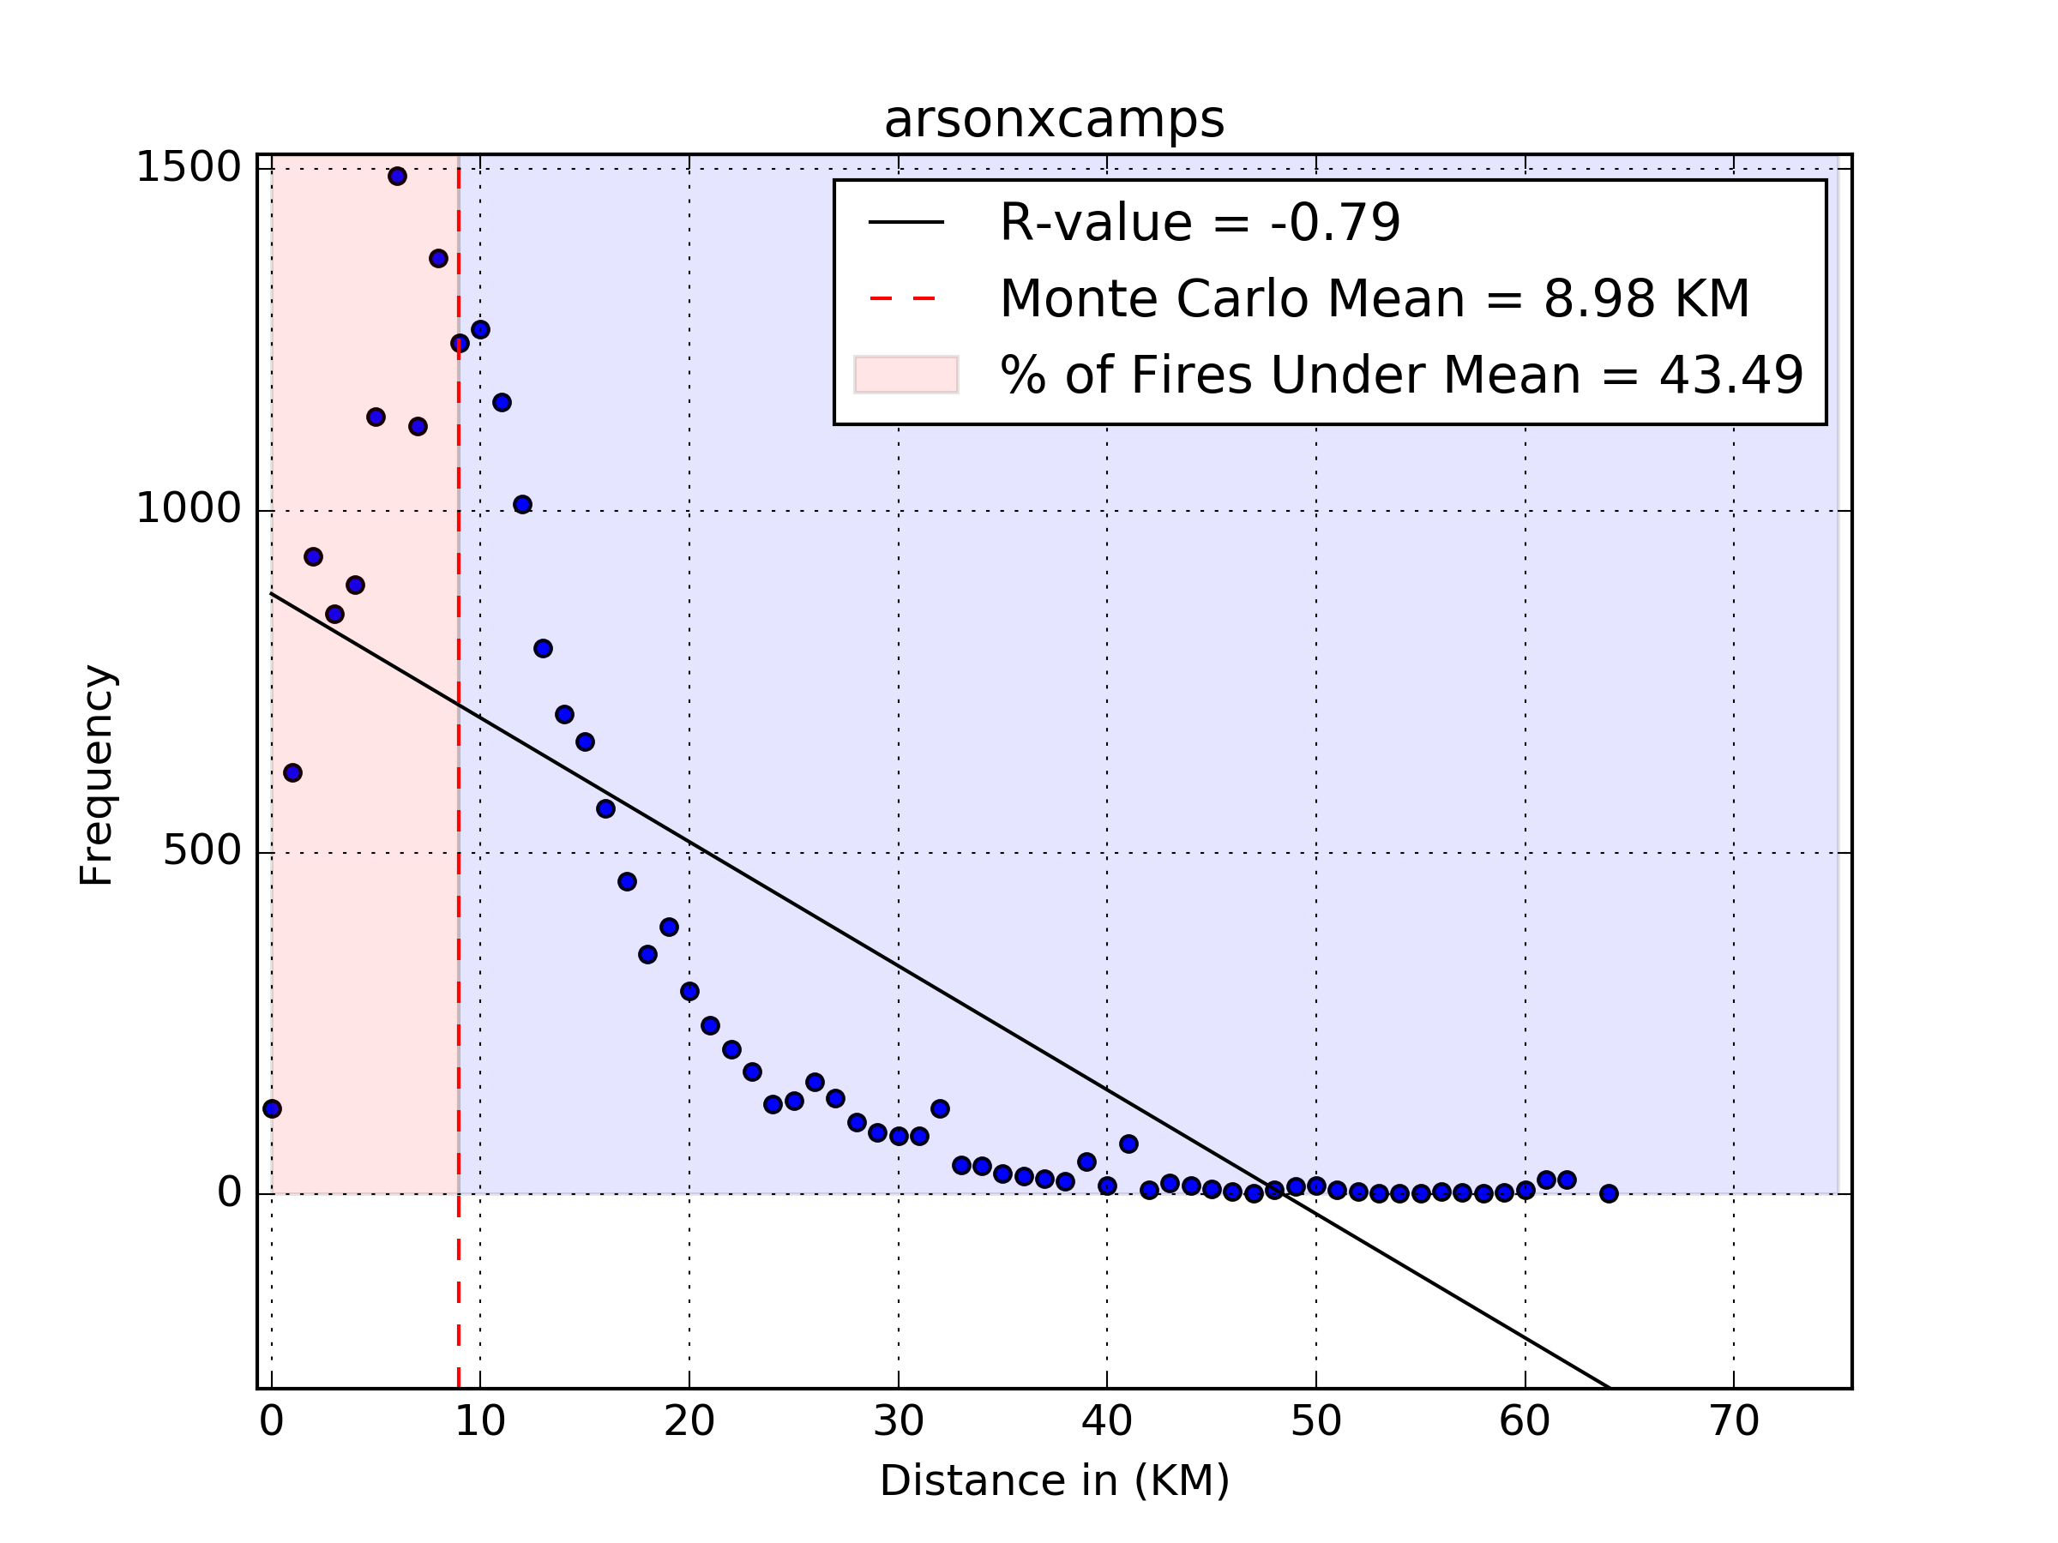
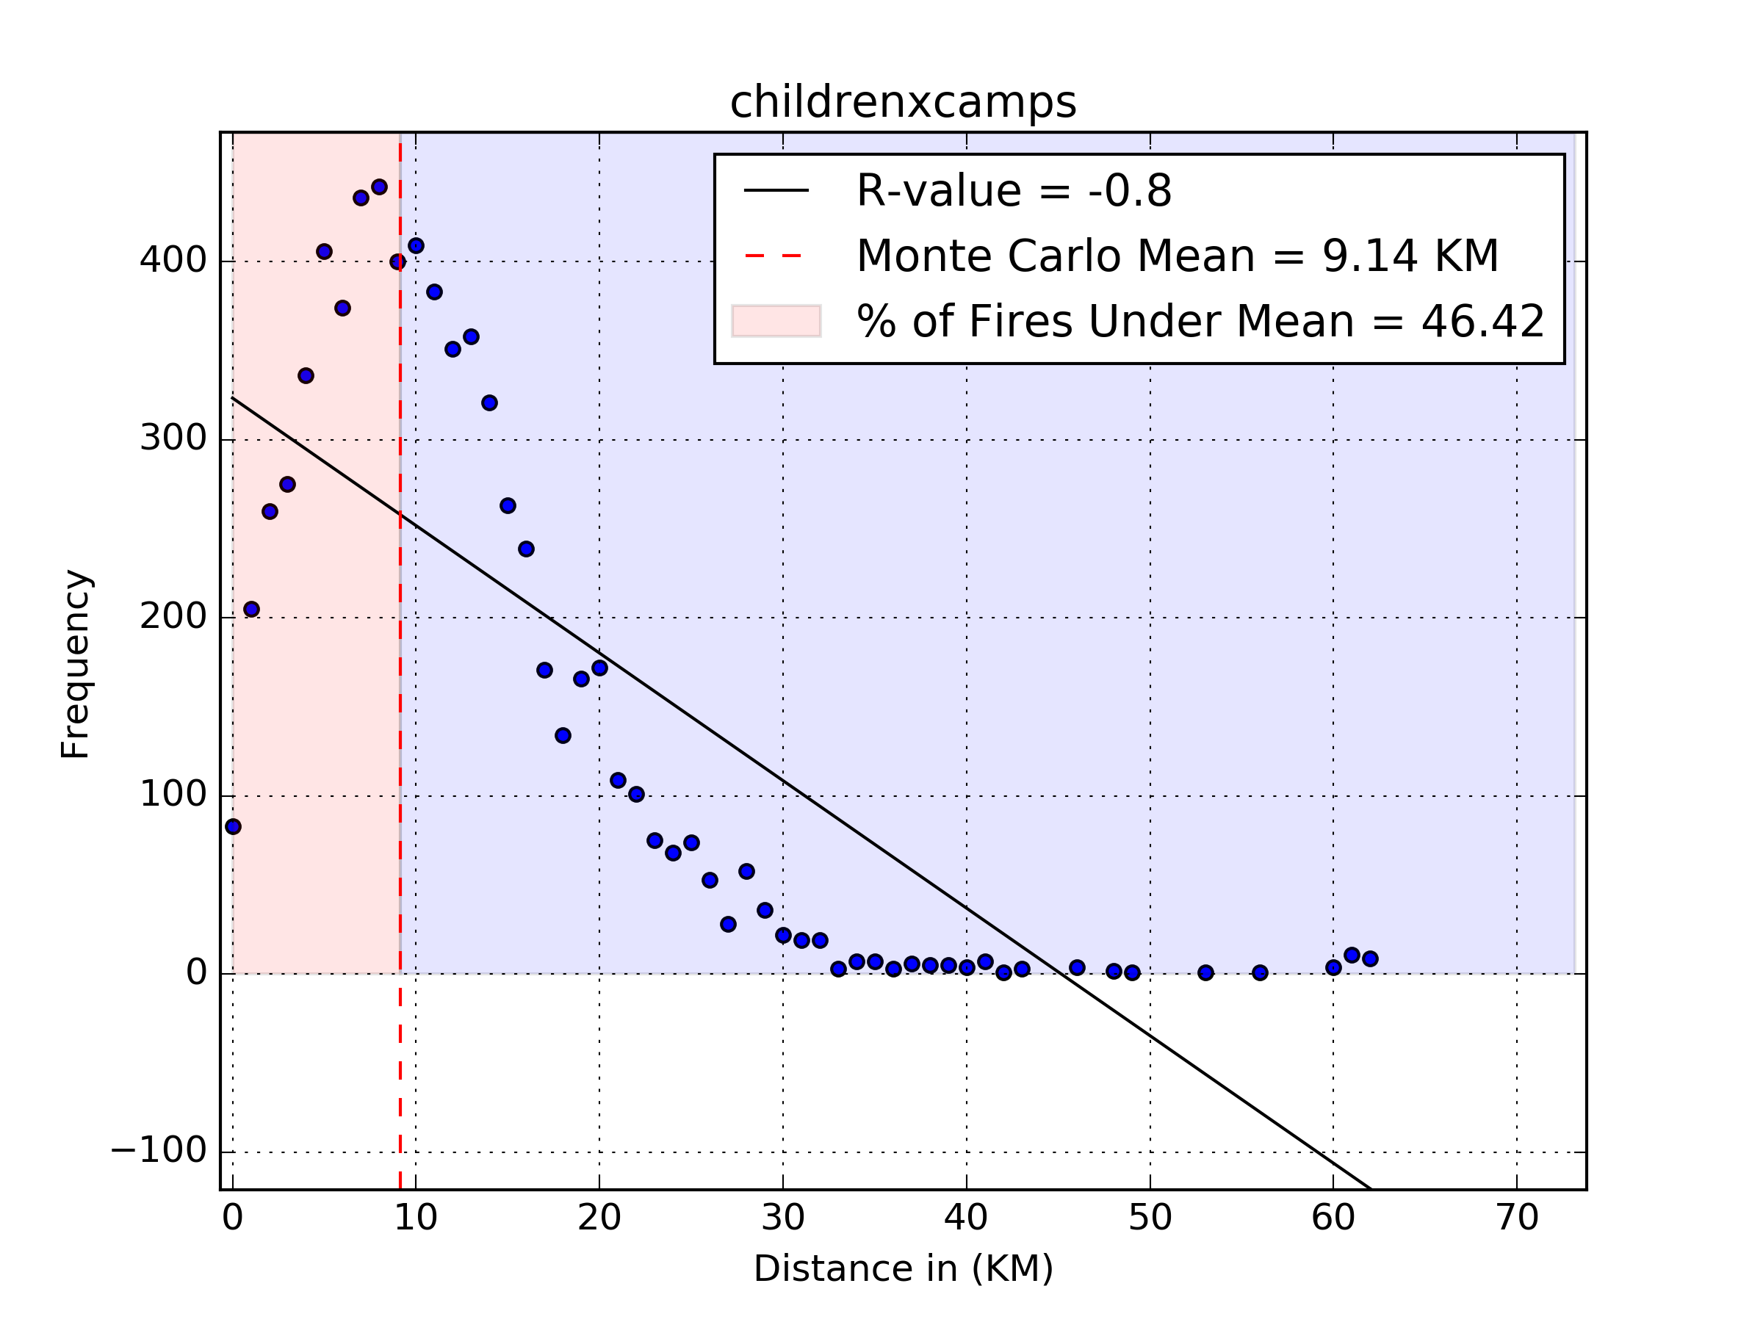
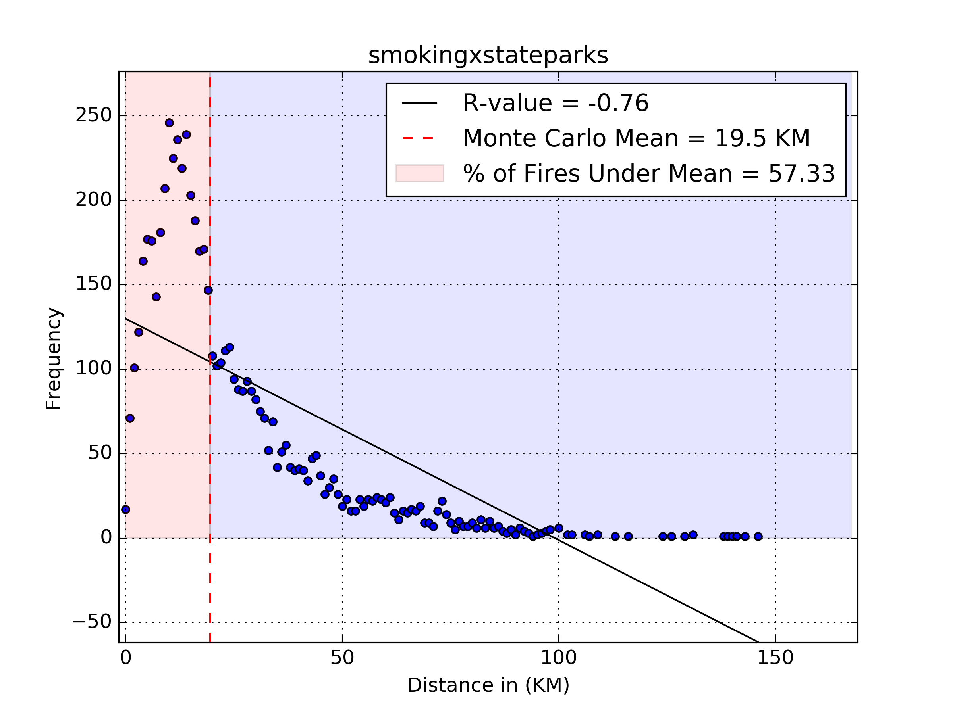
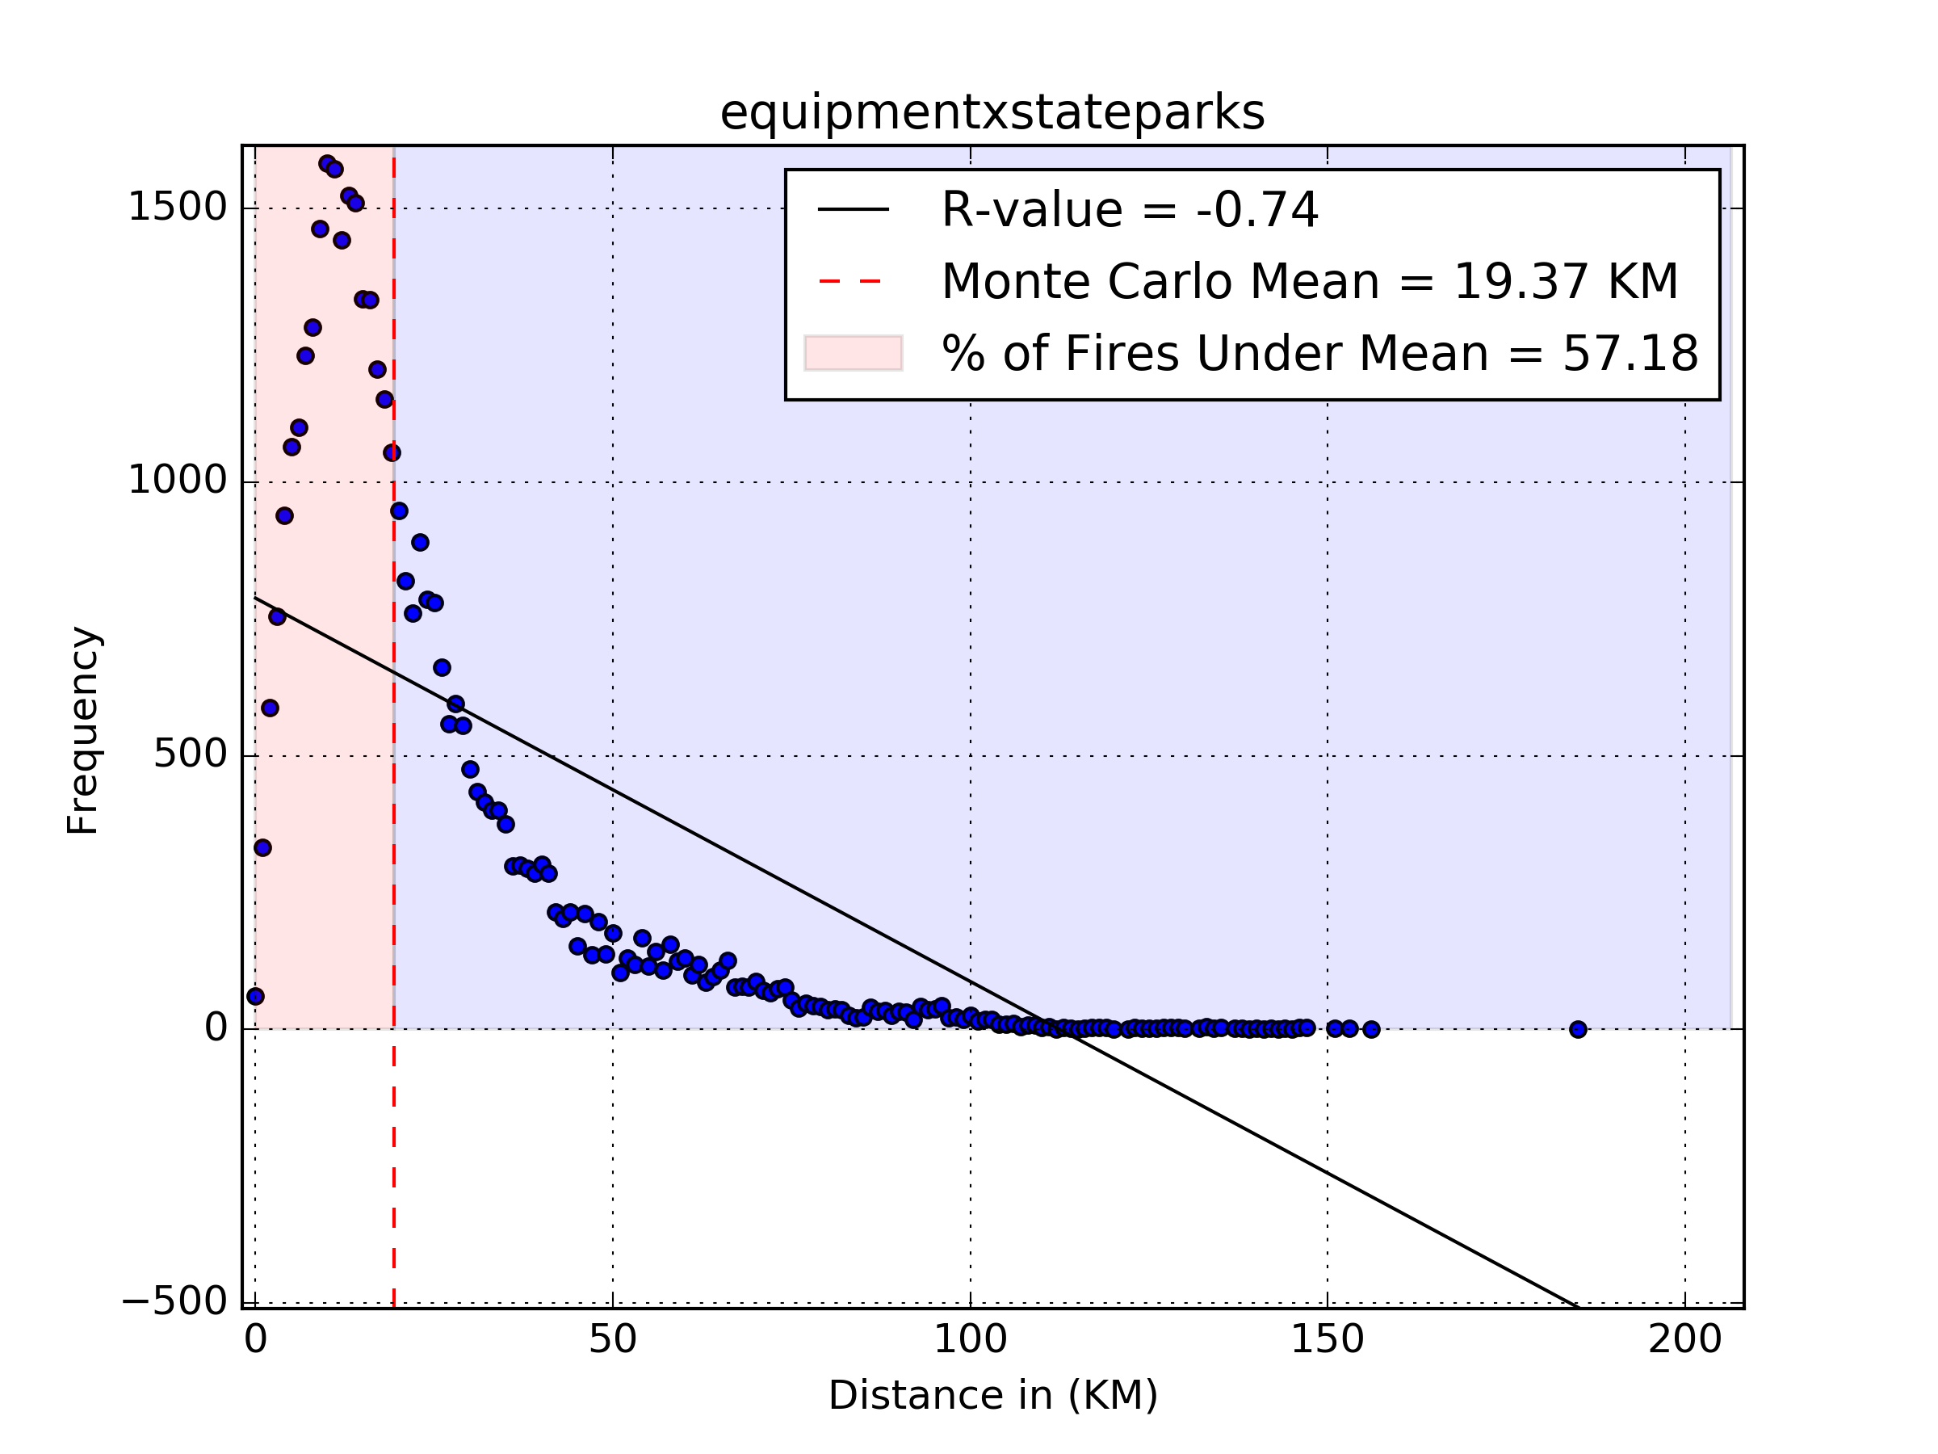

Slide 11
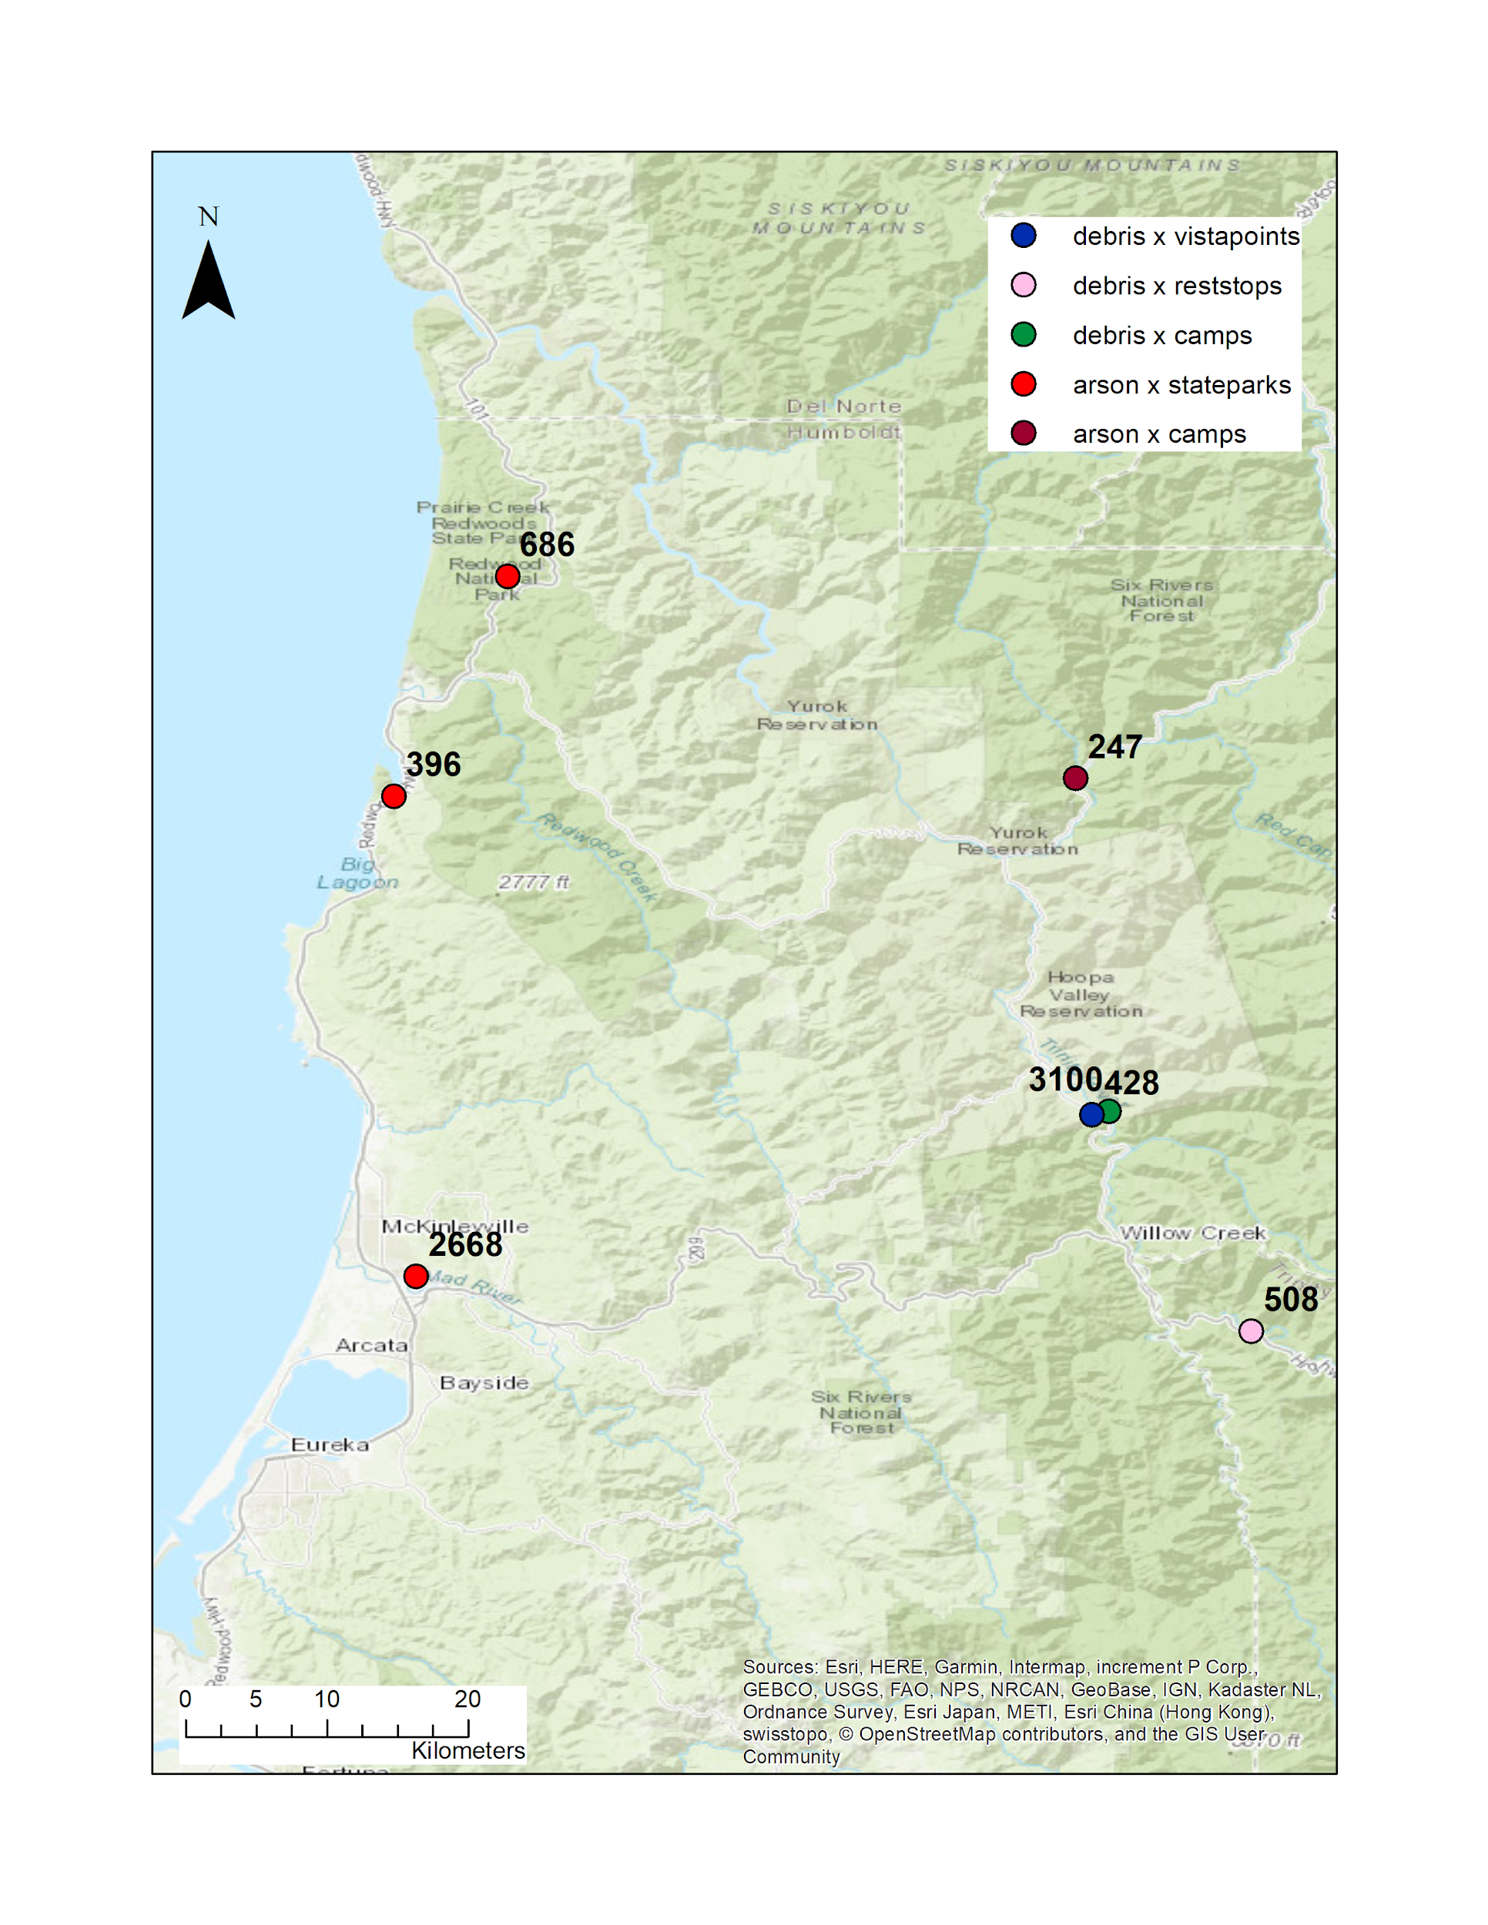
Results - Hot Spots Analysis
Additionally I added a small function to find the
10 locations of each type found to be the
closest to the most wildfires.
Of 360 top 10 locations in California, 8 or
2.22% were in Humboldt County.
Specifically arson and debris burning wildfires
indicating Humboldt County has room for
improvement in these area.

Slide 12
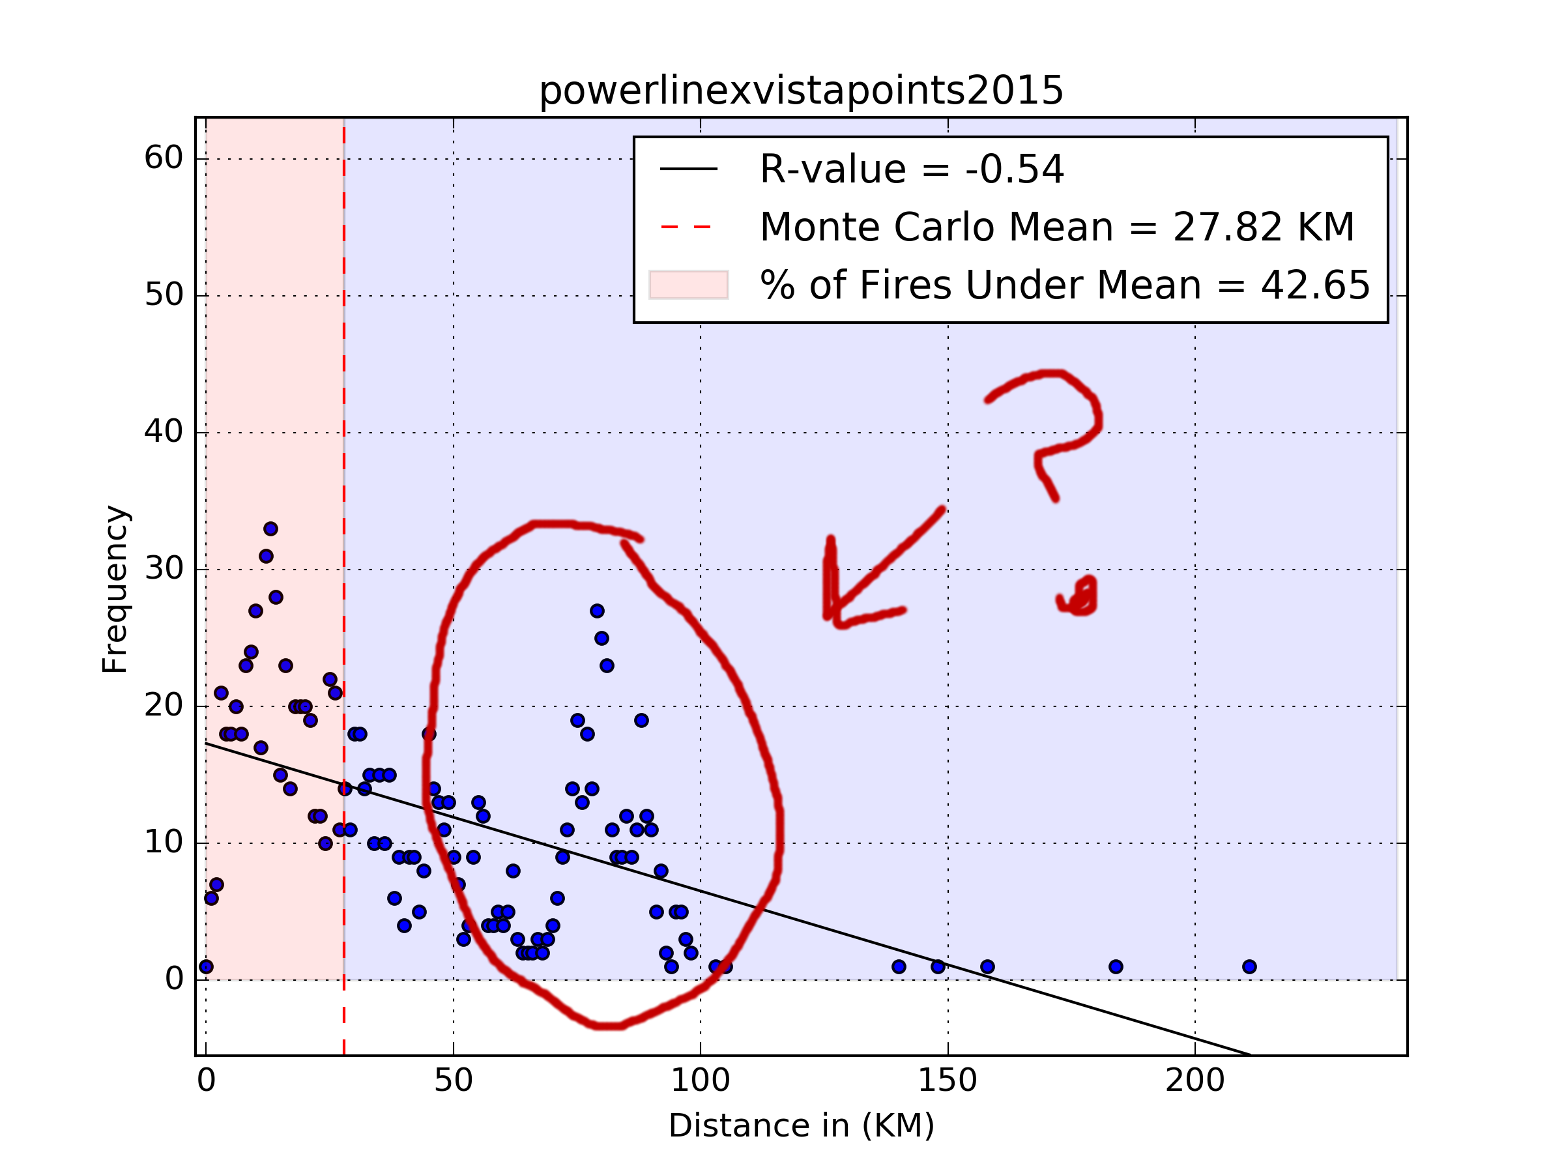
Discussion
Doesn’t necessarily mean causation.
There does seem to be some some
sort of pattern.
Further research may be able to
narrow out other possibilities.
It does give an idea of where to
investigate and it shows that there are locations where,
at the very least, may be impactful to have more wildfire prevention information available at these particular locations.

Slide 13
Problems and Solutions
Comparing files from two different locations - Create a list of file names, run through the list.
Speed - Iterating through a list is faster than array / list comprehension; put a function in the list.
When adding to a list unfeasible write to same file without overwriting it - append option, must rewrite and remove at end.

